Slide 1
Homescapes: Engaging In Glovircal Landscapes of Learning
Dr. Susan Mossman Riva
Department of Cultural and Social Studies, medical anthropology program
Creighton University Omaha, Nebraska

Slide 2
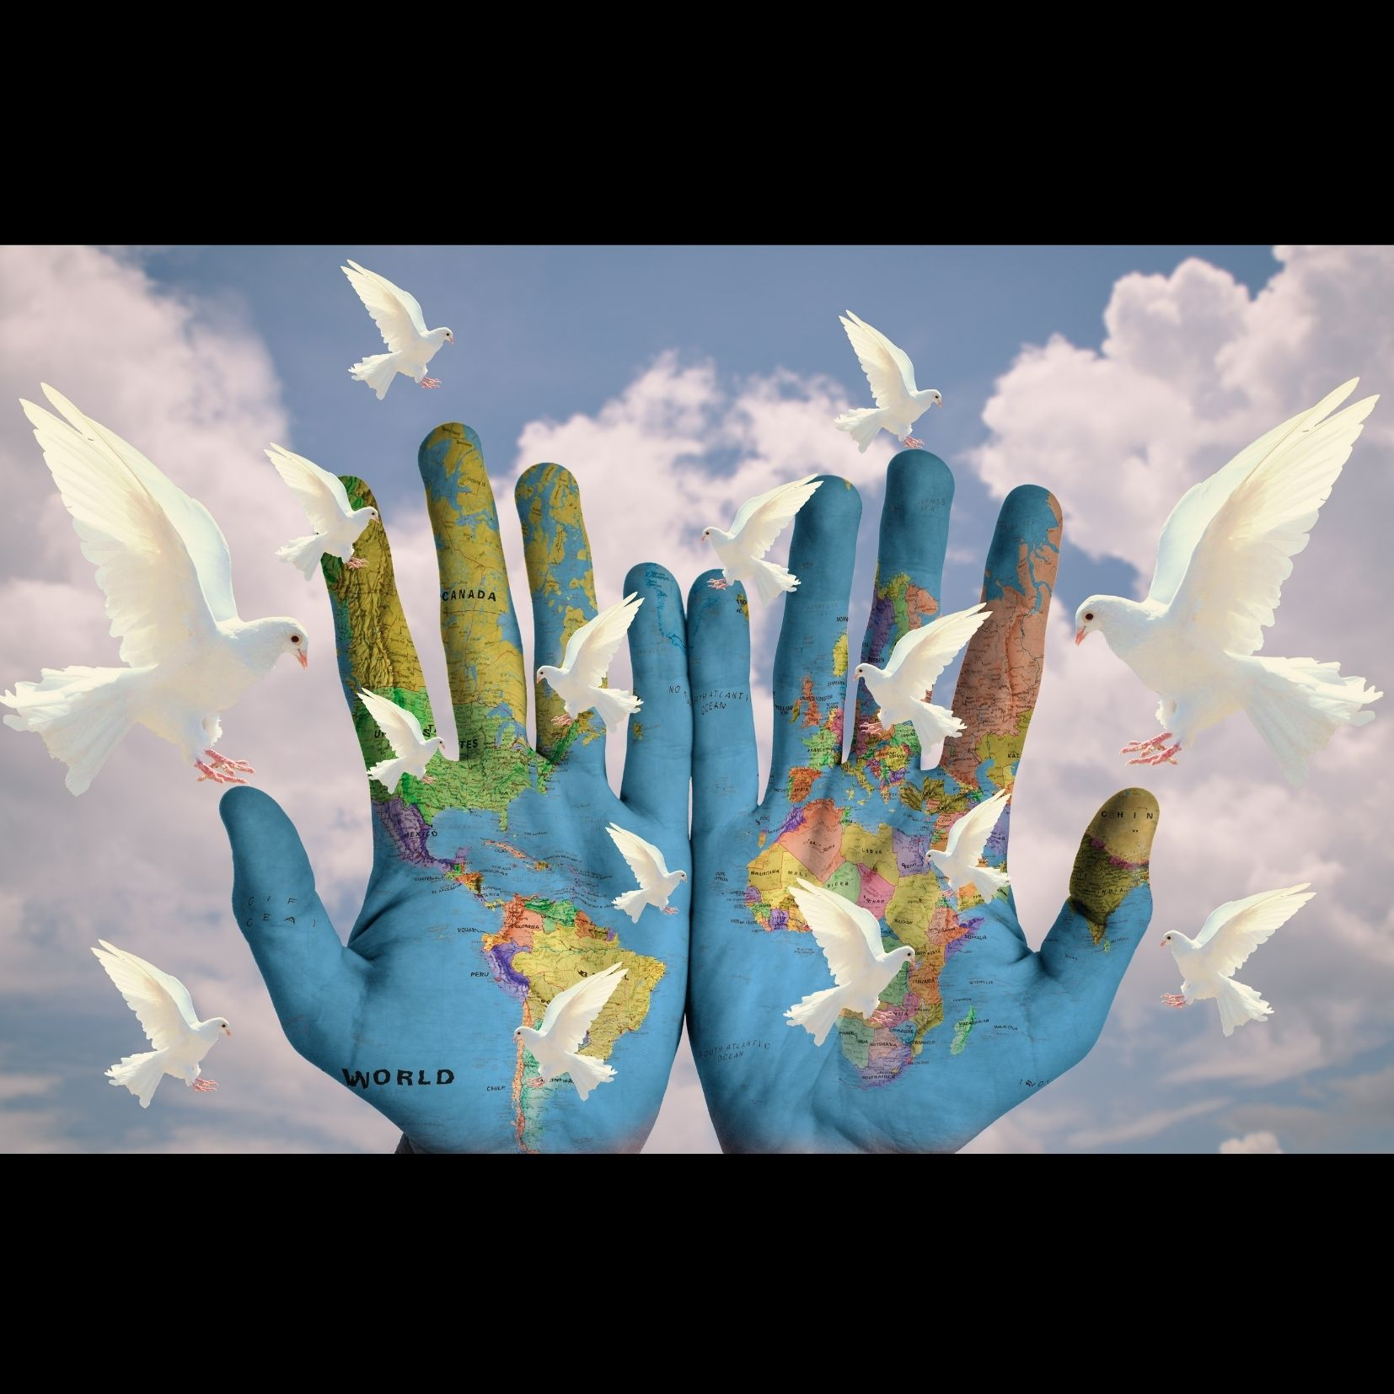
Activism & Advocacy:
Sustainable Development: The Olympic School
Mediation:
Inclusion & Mediation Services for Political Asylum Seekers
Mental Health Reports: Migrant health and LGBTQ health
The Senior Living Lab
Transformational Learning Pedagogies
Engendering Social Transformation through autoethnography

Slide 3
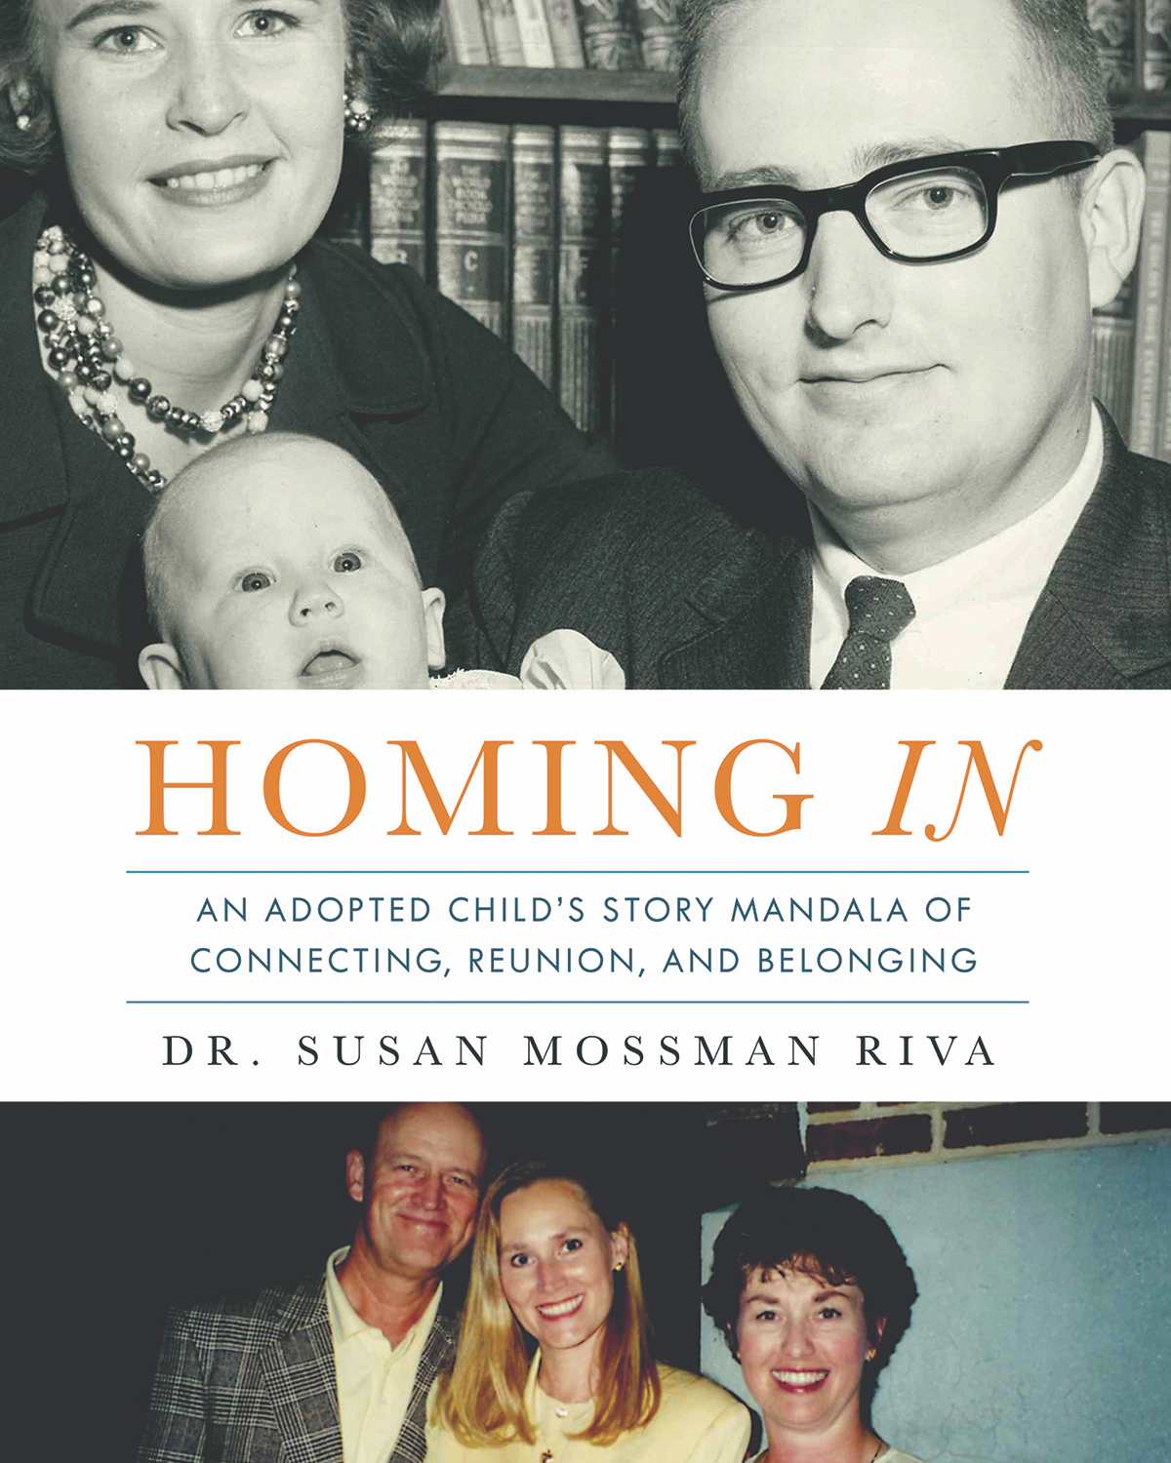
Incorporating Narrative Methods
Autoethnography
Duoethnography
A « Transformagram » pedagogy that emerged from my autoethnographic process and teaching story
http://www.susanmossmanrivawrites.com

Slide 4

Homing In to Earthship:
From Kinship to Earthship
“Kinning”
A Relational Approach
Teachers as Storytellers
Activating the Inner Compass for Quest Orientation
Connecting Lived Experience with Theoretical Frameworks

Slide 5
Connecting with Online Learning Communities in Virtual Spaces: Homescapes
Creighton University Online Learning, Department of Cultural and Social Studies
Jesuit Worldwide Learning-Higher Education in the Margins
Corona Diaries Project: https://boasblogs.org/curarecoronadiaries-info/about/

Slide 6
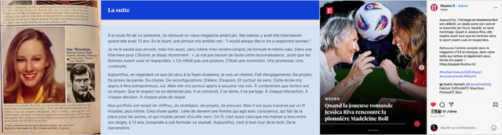
Intergenerativity: Womens Football Generating Social Tranformation

Slide 7

Divine Timing, Synchronicity,
Transmission
Passing on the Golden Pocket Watch
Transmission in Higher Education
A Timepiece for Resetting
Cette photo par Auteur inconnu est soumise à la licence CC BY-NC

Slide 8
The Flexibility Hypothesis of Healing
Applying theTransformagram Concept to Higher Education
The schema that represents the transformation could be termed a ‘‘transformagram.’’ The transformational schemas often operate by first introducing an analogical state or image, and then bringing about a transformation in the analogue, which influences the afflicted person’s original mirrored state, what might be called the therapeutic technique of ‘‘mirror-and-shift.’’ The notion of transformagram is broader than that of metaphor because it may include other forms of trope, imagery, and embodied or enacted transformation.
-D. Hinton and L.J. Kirmayer (2017)

Slide 9
From Life-o-grams to Transformagrams
Using transformational pedagogies to generate individual and social change processes.
Designing practices and methods that open space for constructive social change using auto/duoethnography.
Creating methods that engage and transform lifelong learners. Cultivating an integral approach to the Ascona Charter

Slide 10
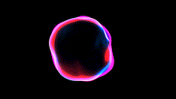
Notes:
Engendering glocal communities of practice

Slide 11
Transformagram Portfolios replace a traditional final paper. They consist of students answering questions inspired from Dr. Arthur Kleinman’s work on illness narratives. His work inspired my thesis on Conflcit Narratives in the context of intercultural mediation. The questions create reflexivity about the illness or conflict narrative the student has chosen to develop for their portfolio.
Video of the conflict/illness narrative
Story mandala incorporating aesthetic representations with course literature
Kleinman’s questions generating the autoethnographic process
Cartography of resources and relationships
Reflexive space with duoethnographic partner

Slide 12
Transformagrams elicit both flexibility and reflexivity
Opening
Opening experiential learning space for lifegiving practices including conflict resolution by modeling openness and storytelling.
Initiating
Initiating an Integrative Medicine approach that allows students to co-construct a holistic healing strategy.
Giving
Giving value to medical pluralism generates constructive social change by sensitizing future practitioners.
Developing
Developing Narrative Inquiry and Appreciative Inquiry approaches with reflexive portfolio evaluations/interviews reinforces the process
Evaluating
Evaluating the effectiveness of this approach is part of the ongoing pedagogical development process.

Slide 13
Mediatorship:
Interconnectivity that elicits directinality and wayfinding through the autoethnographic process
As biomedicine is the dominant medical approach in the Western world, mediating pedagogies are needed to teach future practitioners about complementary and alternative medicine, as patients increasingly seek out these practices.
Engaging with conflict and illness narratives
Engendering Conflict Wisdom

Slide 14
Mediatorship:
A Vessel of Mediation Practices
Using Conflict Resolution to meet the U.N. Development Goals
Incorporating Nations United: https://www.un.org/sustainabledevelopment/blog/2020/09/united-nations-calls-for-collective-action-in-special-2020-broadcast/
Engaging with Conflict Narratives
Accomapnying students as they engage in reflexive and tranformative learning processes
Beholding an Interrelated and Interconnected Worldview

Slide 15
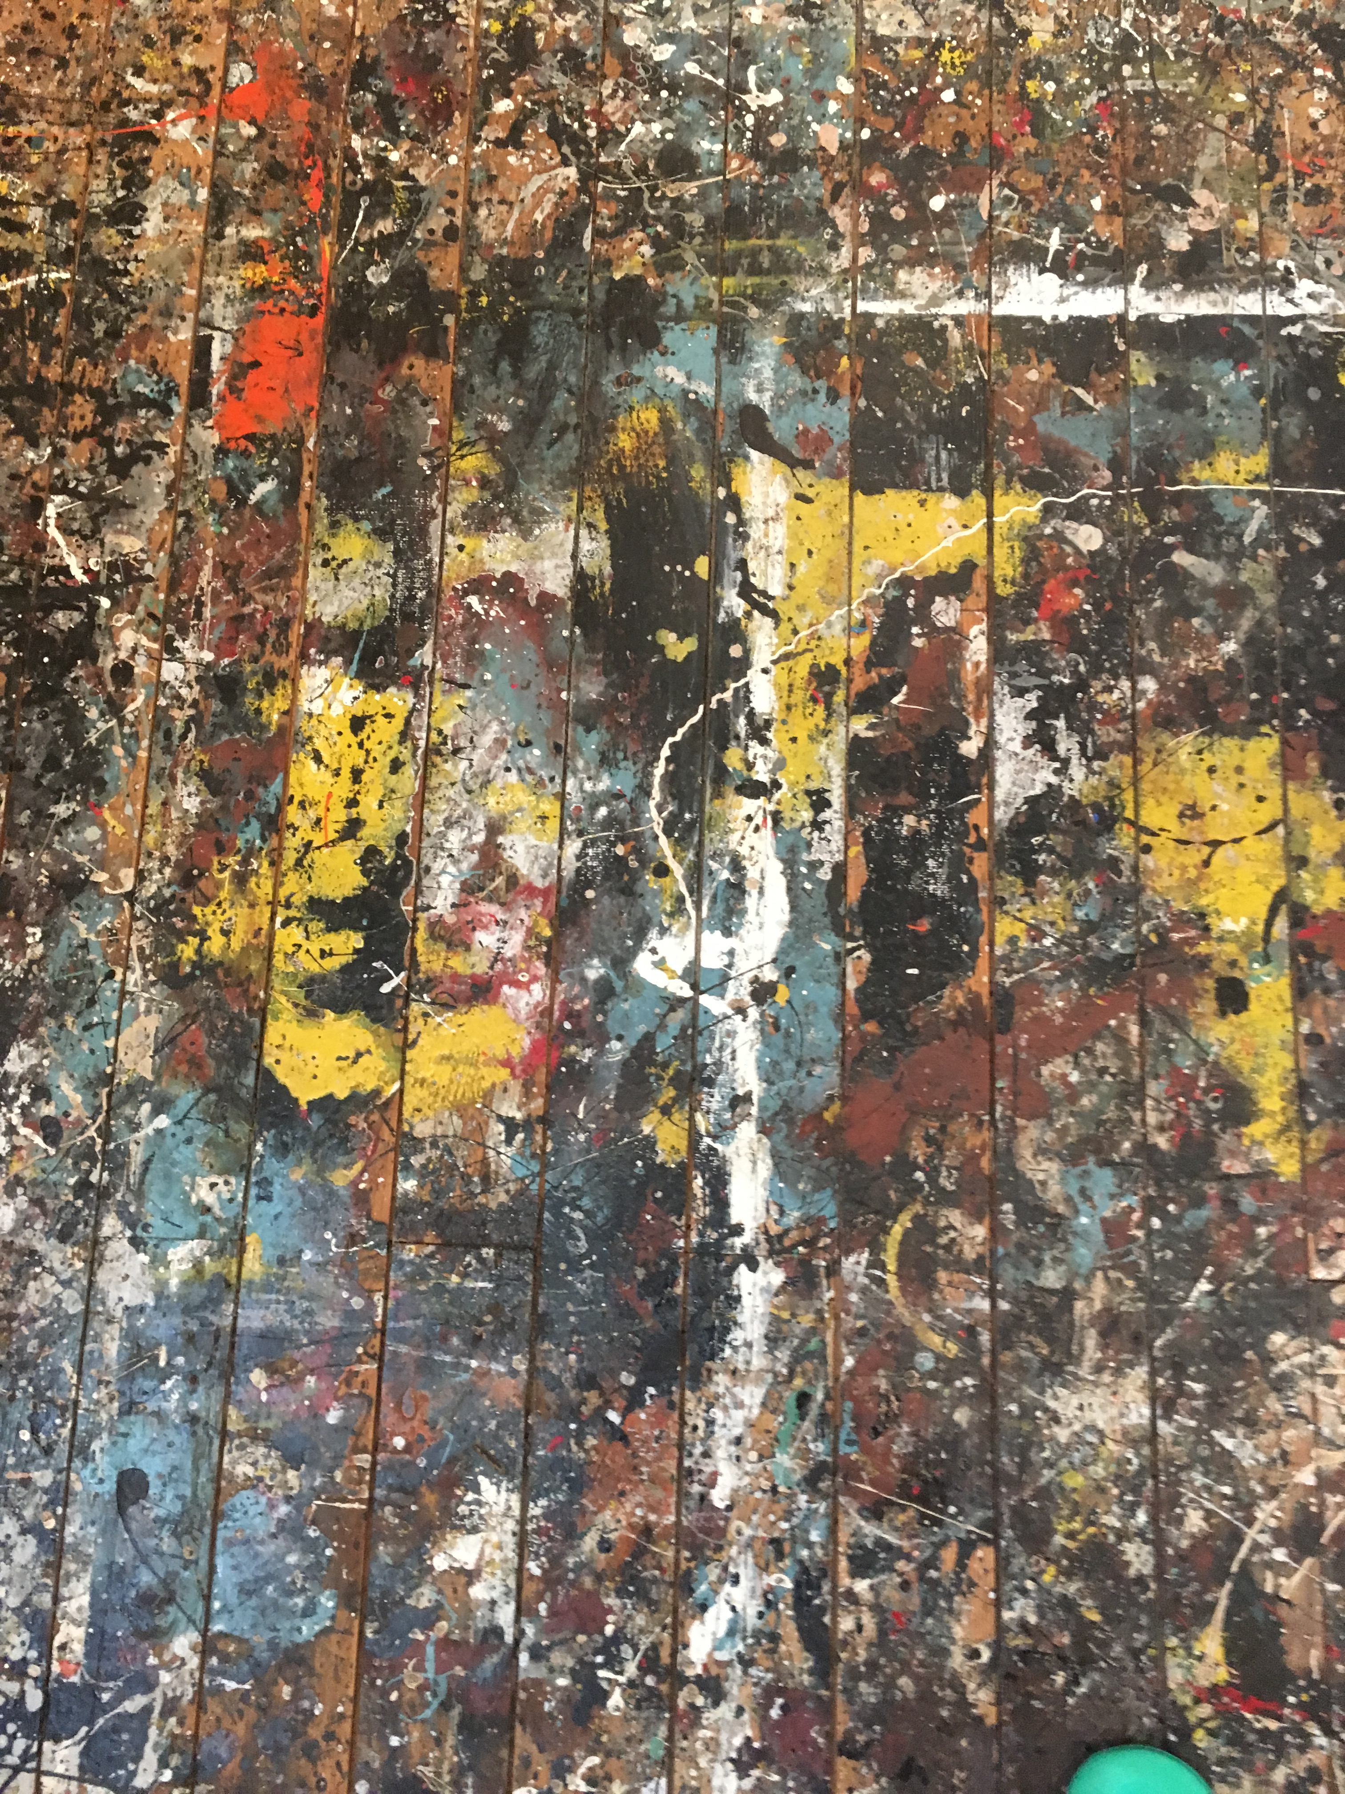
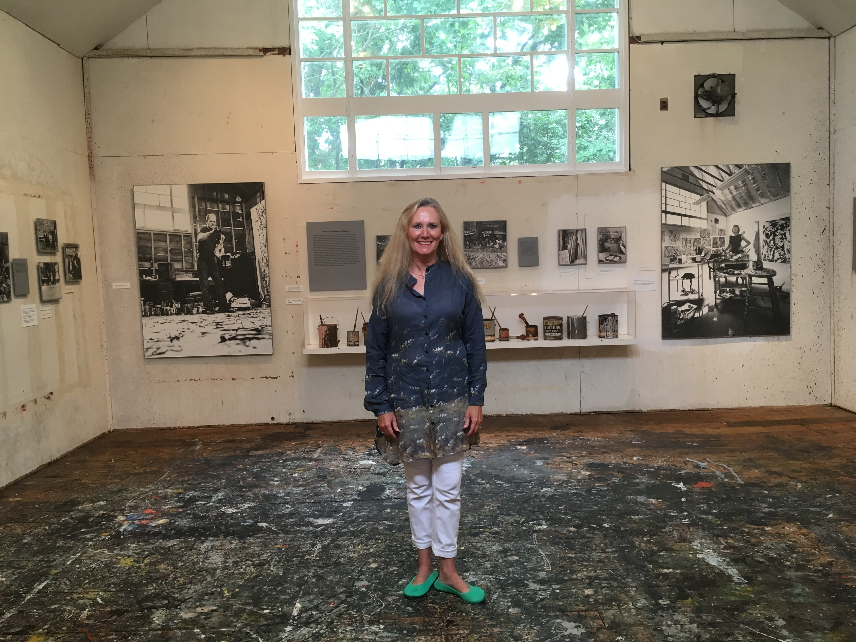
From New Deal Art inspired from the Pollock Krasner House and Study Center to Green New Deal Storytelling has led to developing presentations and pedagogy for High School students in Valais-generating a cultural shift
“I will propose a European Green Deal in my first 100 days in office.
This will include the first European Climate Law to enshrine the 2050 climate- neutrality target into law.
I have been inspired by the passion, conviction and energy of the millions of our young people making their voice heard on our streets and in our hearts. It is our generational duty to deliver for them.»
-Ursula von der Leyen

Slide 16
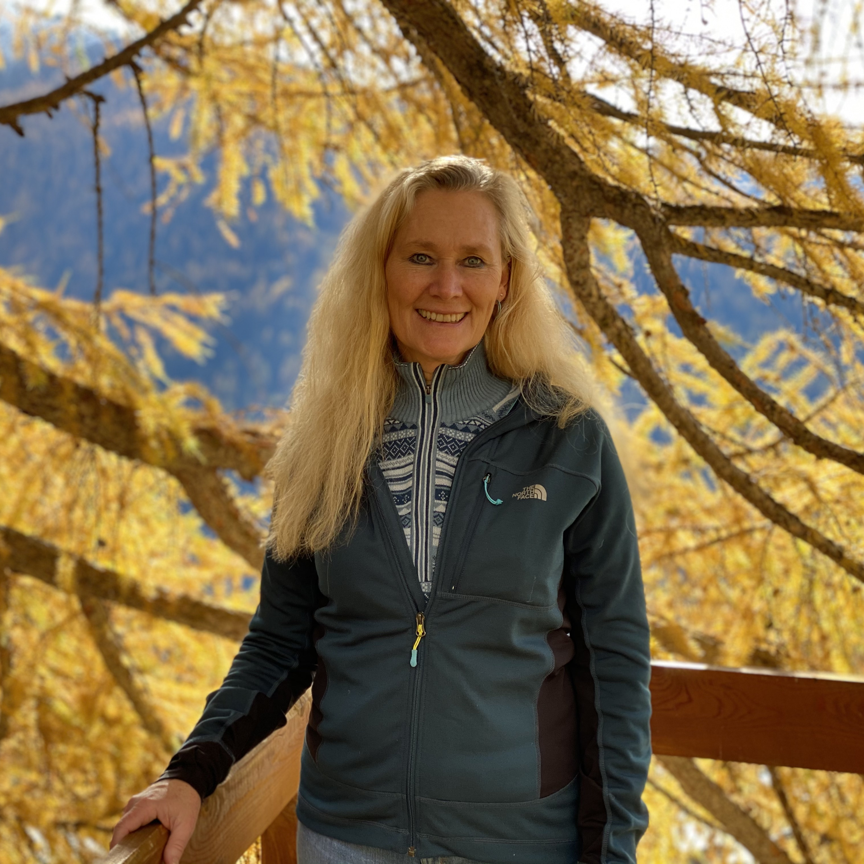
Seeding an Ecology of Life
A Culture of Care and A Culture of Encounter
The Transformagram Learning Model
Integrative Medicine
Conflict Resolution
Integral Ecology and Social Justice
Future Forming Research
Autoethnogtraphic and duoethnographic methods

Slide 17
Medical Anthropology Program:
FosteringTransformative Anthropology
Creighton University Department of Social and Cultural Studies
The Medical Anthropology program offers « An Anthropological and Transformative Approach to Alternative and Complementary Medicine »
« An Introduction to Conflict Resolution »

Slide 18
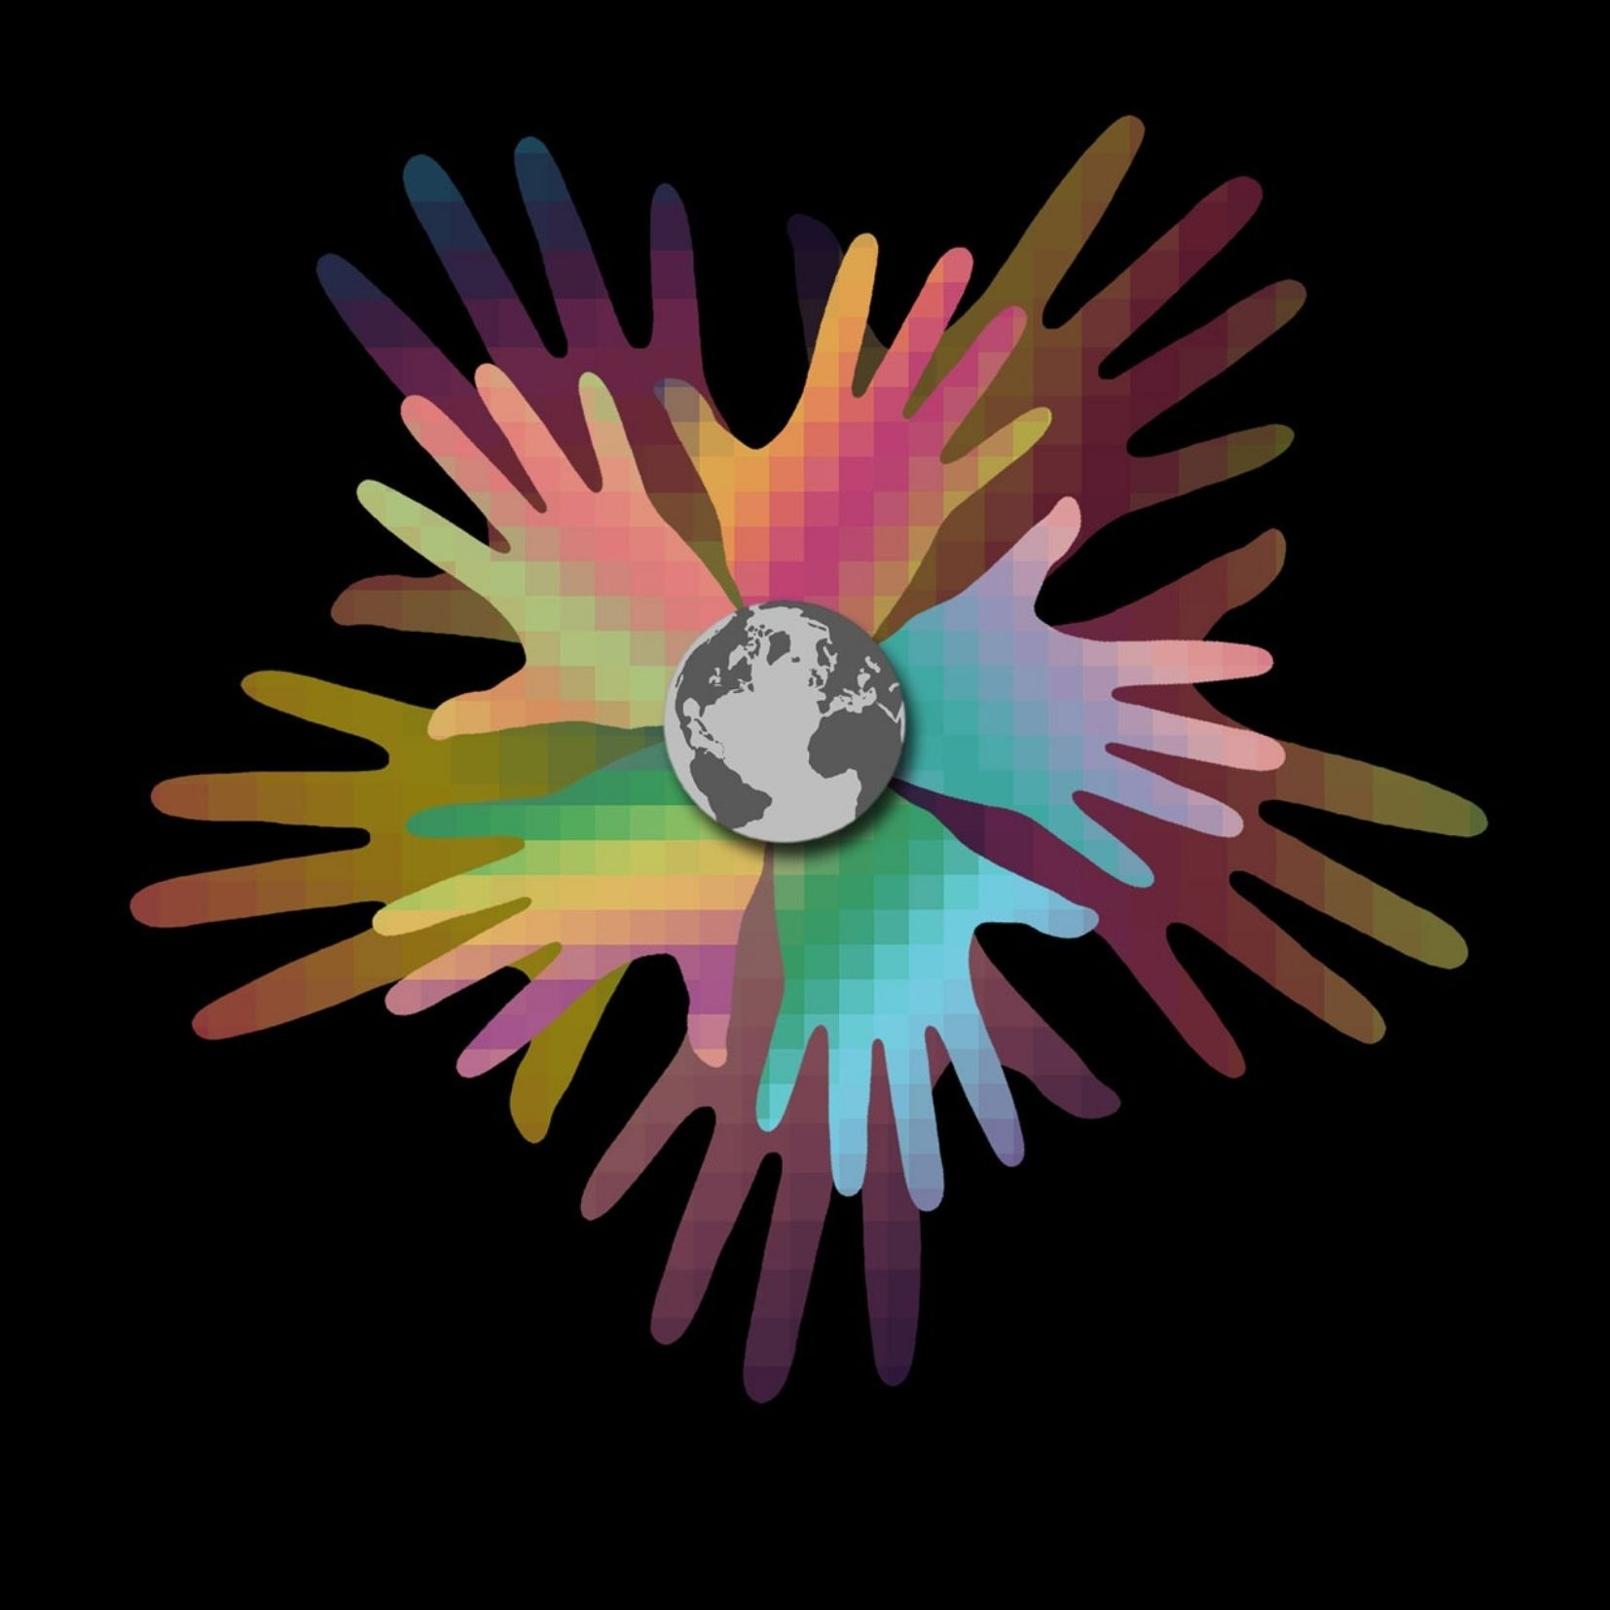
We need a new story and new flyways to future form. In a space of creative flexibility we co-design transformagrams
Thomas Berry-The Dream of the Earth
Sara Cobb-Narrative Conflict Resolution
Kenneth Gergen-Relational Being
Kirmayer and Hinton- The Flexibility Hypothesis

Slide 19
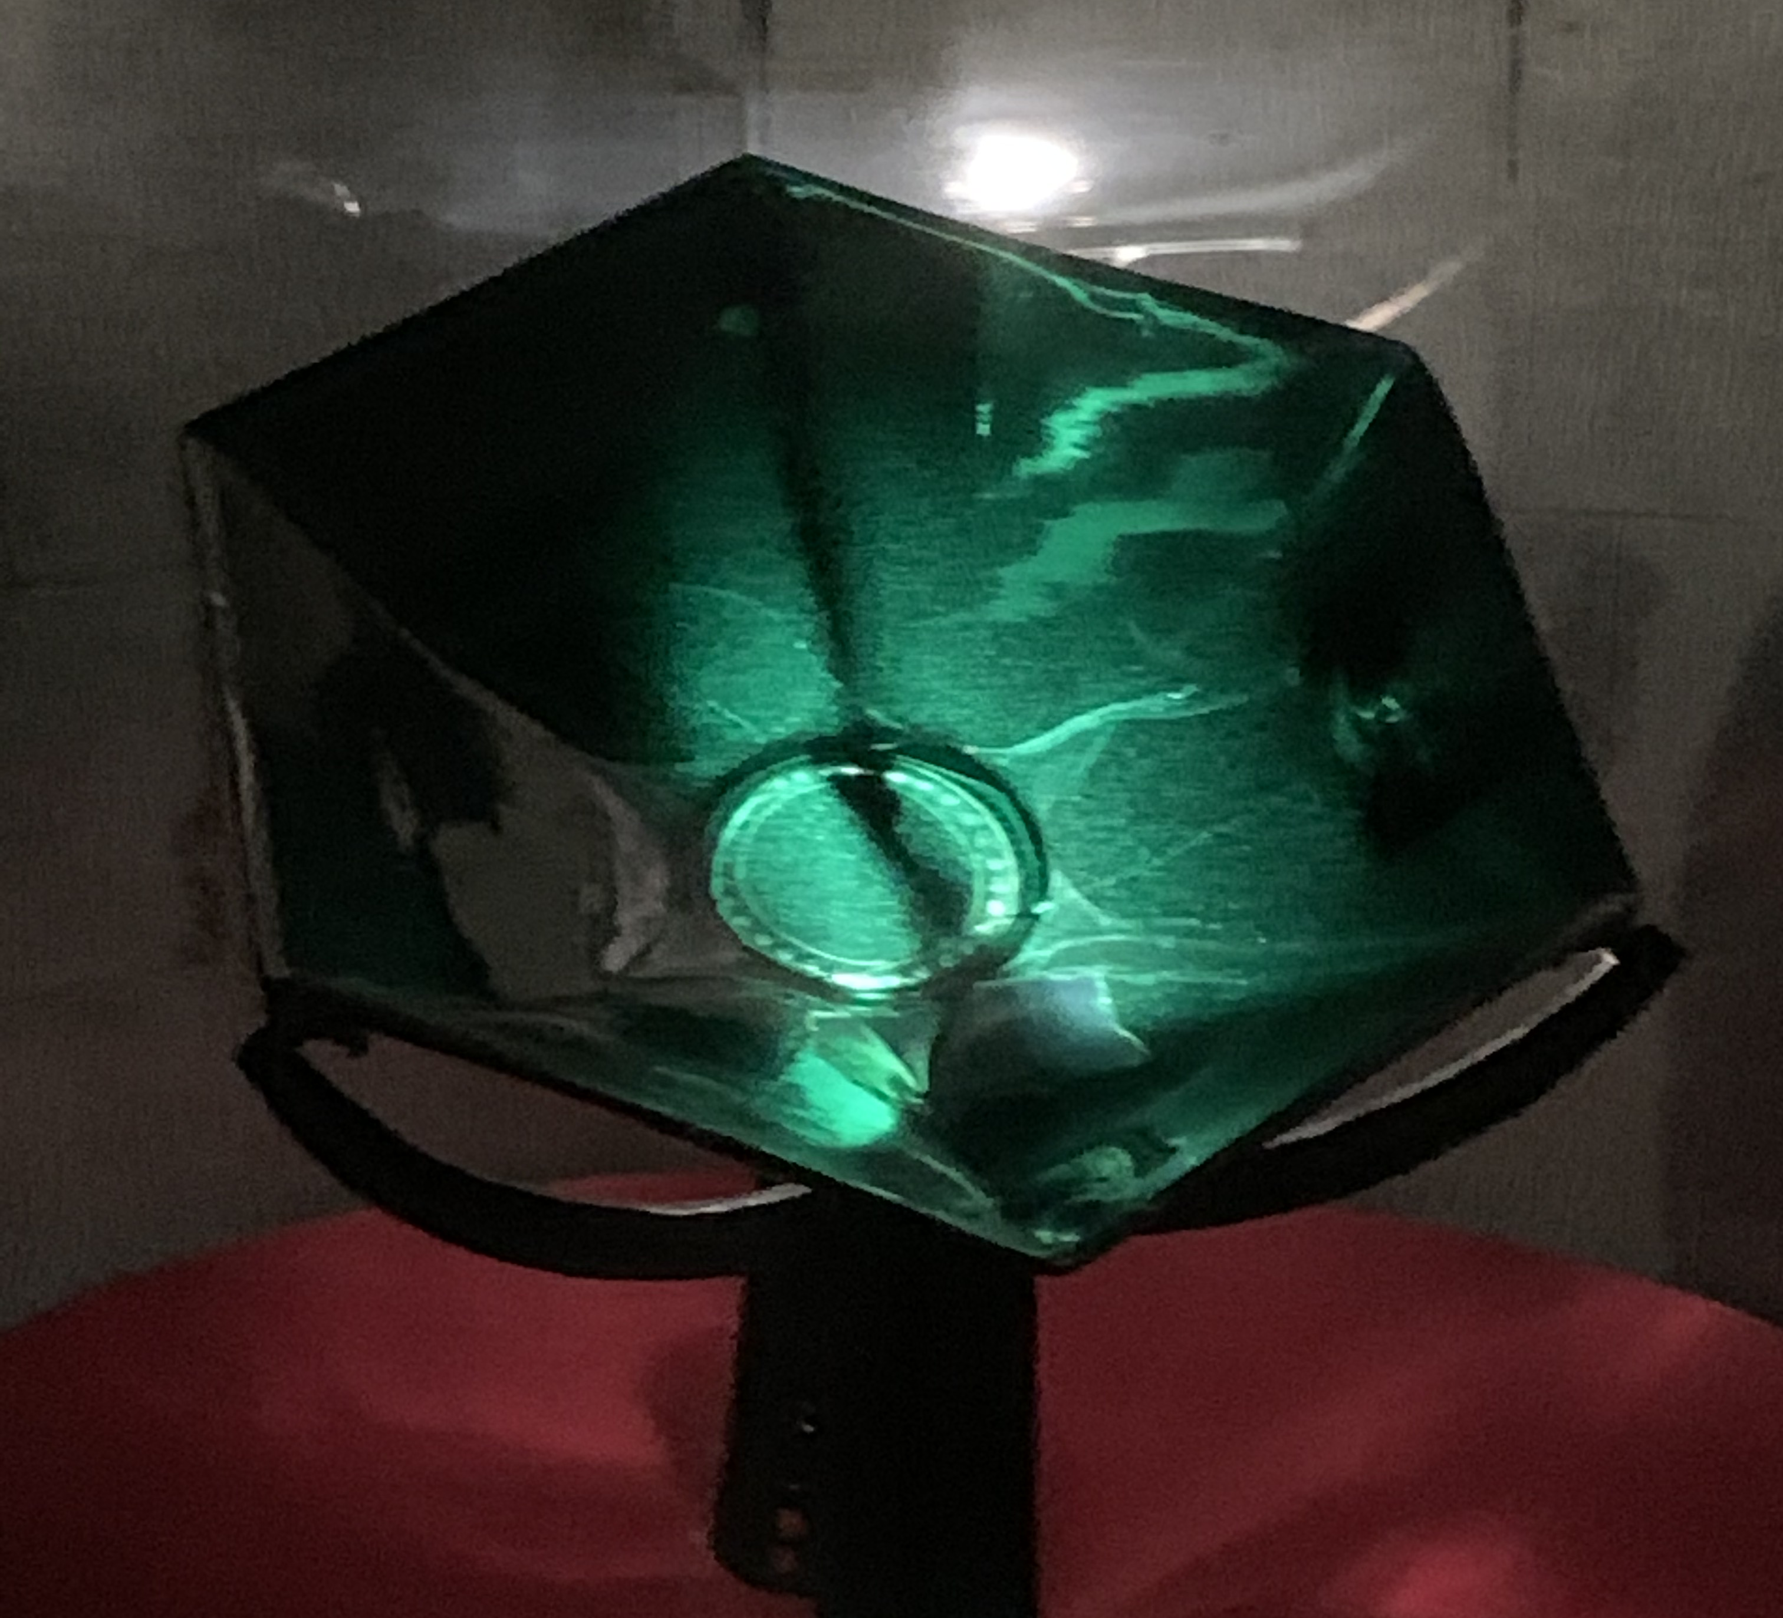
Walkthrough-
Sacro Catino
The Holy Grail Way opens through our conflict and illness narratives.
We are storied beings. Subsequently, the power myth has to transform life history is ever present. Refashioned and retold, the Holy Grail is a vessel, a sacred quest, and a legend with the power to enchant and transform. Storying gives form to existence. Our stories are an intricate part of our cultural inheritance. By recognizing the significance of synchronicities, additional layers of meaning and significance are invited to permeate reality, revealing a sacredness hiding behind the thinning veil (Riva, 2020).

Slide 20
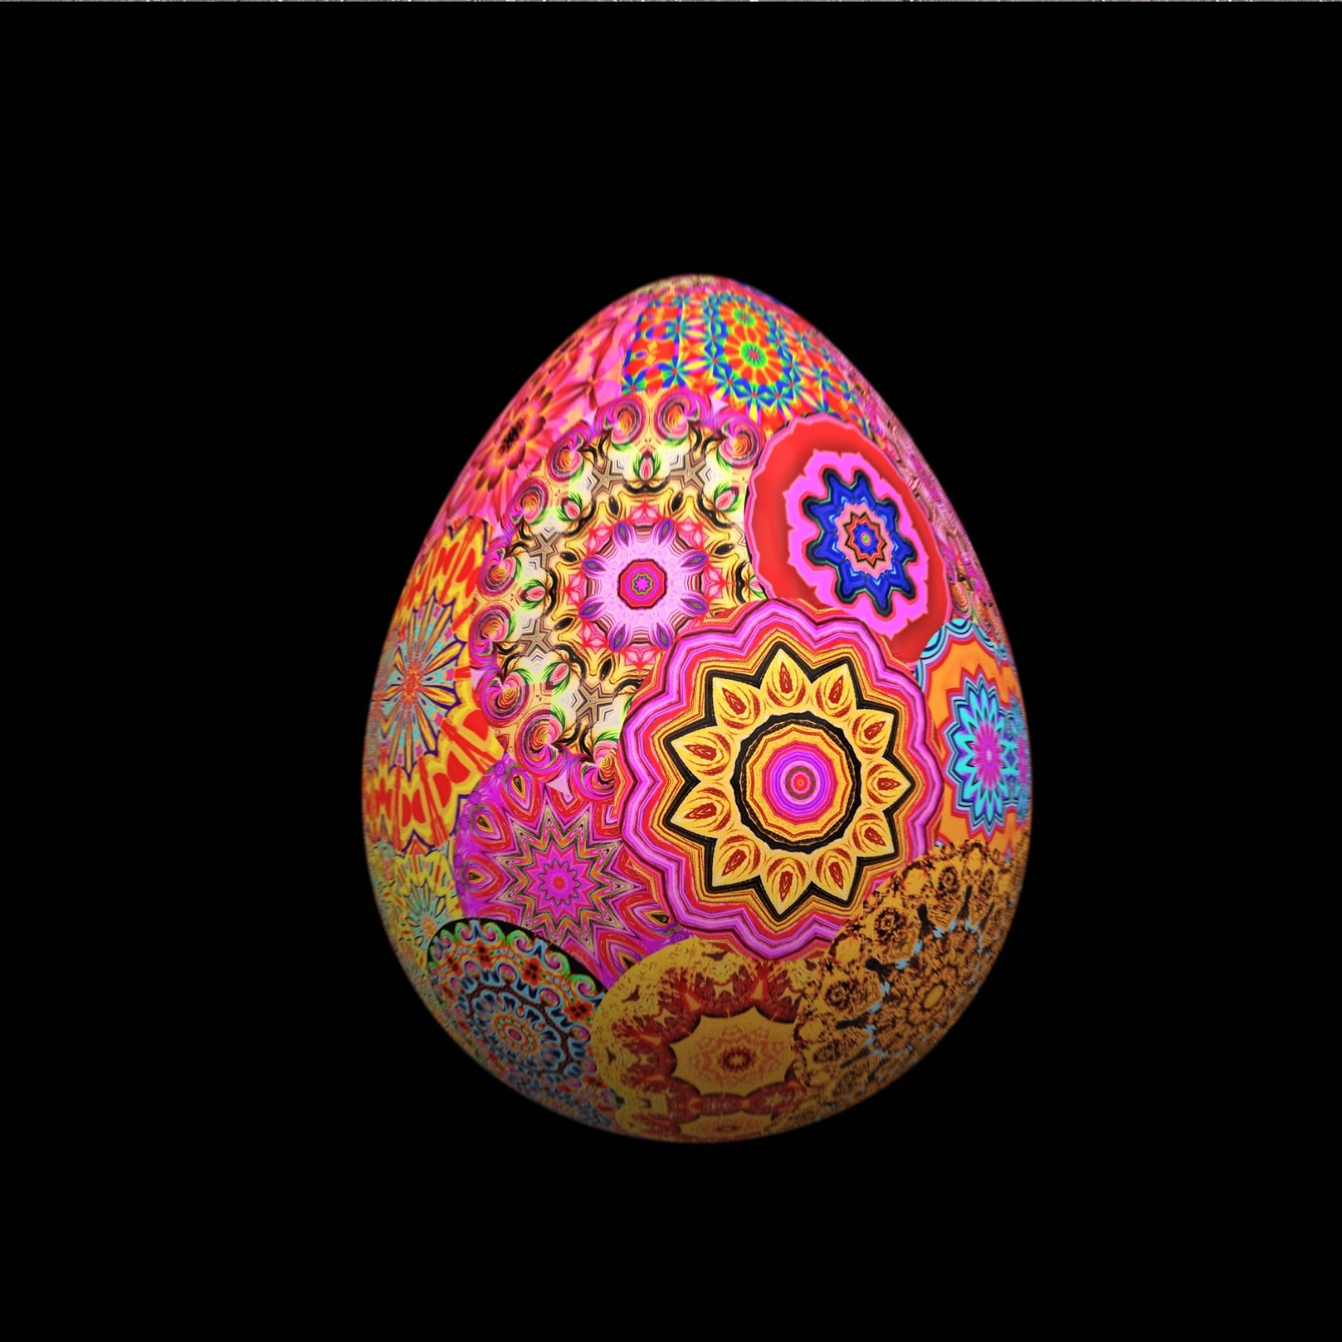
Co-writing narratives of belonging in/on Earthship
Transformational, Spiritual, and Ecological Autoethnography

Slide 21
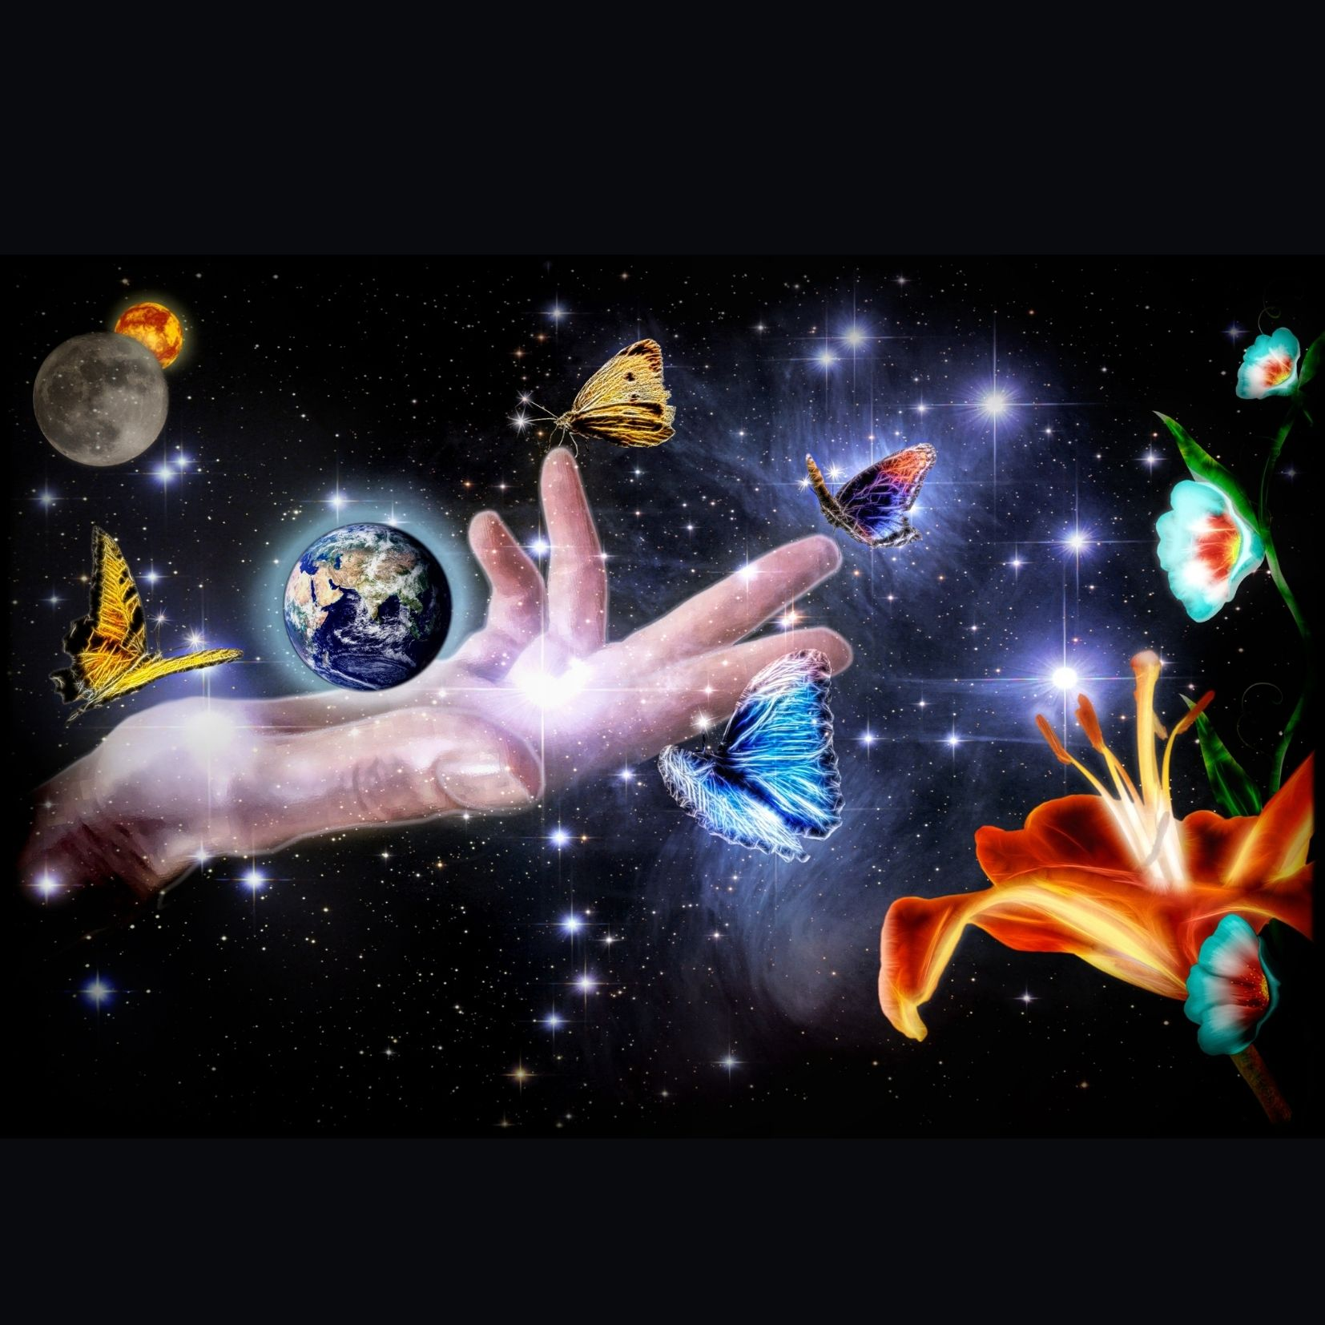
Behold the Emerald Planet
Transforming Perceptions
As I hold the Book of Changes, the I-Ching falls opens to “On the earth is water: the image of Holding Together,” an offering for this ending. Here, hexagram, genogram, life-o-gram, and narrative transformagram are intricately laced together. As we behold, we actively transform the image. When seen from space our emerald planet, Earthship takes on the form of chalice, vessel, and sacred container, holding us together (Riva, 2020).

Slide 22
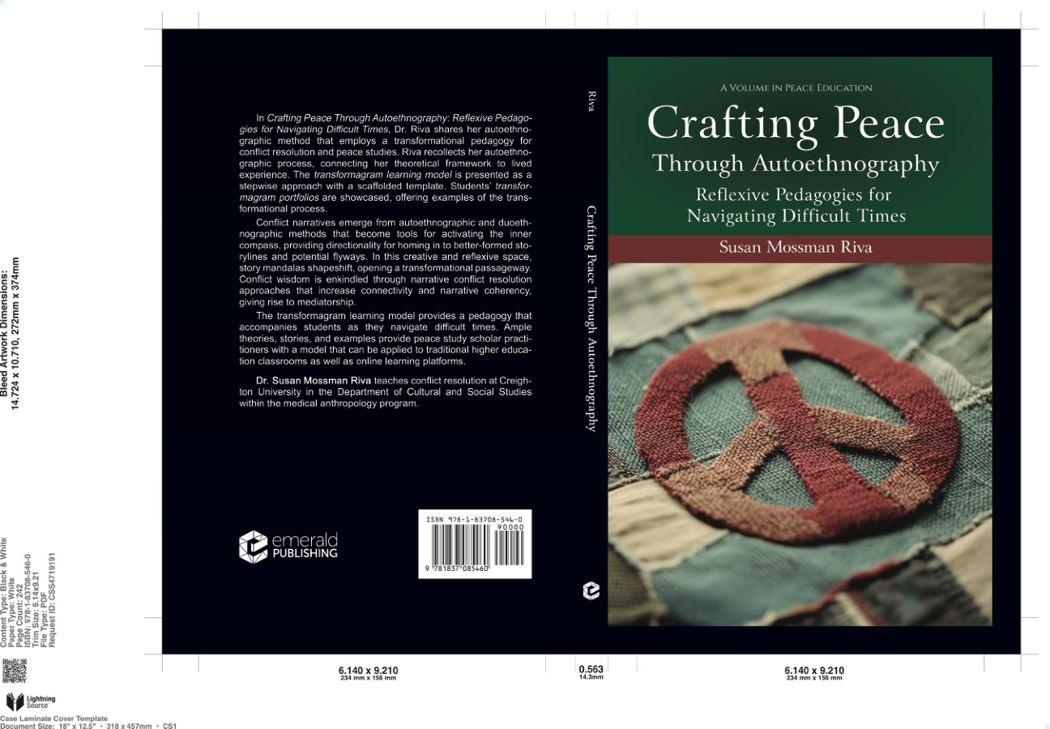
Crafting Peace Through Autoetnography

Slide 23
Bibliography
Cobb, S. B. (2013). Speaking of Violence: The Politics and Poetics of Narrative Dynamics in Conflict Resolution. Explorations in Narrative Psychology. Oxford ; New York: Oxford University Press.
Denzin, N. K. (2014). Interpretive Autoethnography. Second edition. Los Angeles: SAGE.
Francis. Laudato si’. (2015). 1st edition. Huntington, IN: Our Sunday Visitor Pub.
Francis. "Fratelli tutti (3 October 2020) | Francis". www.vatican.va. Retrieved 4 October 2020.
Gergen, K.J.(2015). "From Mirroring To World-Making: Research As Future Forming". Journal For The Theory Of Social Behaviour. Volume 45, Issue 3. 287
Hinton, D. and Kirmayer, L. J. (2017). The Flexibility Hypothesis of Healing. Cult Med Psychiatry 41:3-34.
Kleinman, A. (1989) The Illness Narratives: Suffering, Healing, and the Human Condition. New York: Basic Books.
Micozzi, M. S. (2018). Fundamentals of complementary, alternative, and integrative medicine. 6th edition. St. Louis, MO: Elsevier.
Riva, S. M. (2020). Homing in: An Adopted Child’s Story Mandala of Connecting, Reunion, and Belonging. 1st ed. Christiansburg: WriteLife Publishing.
Sawyer, R. D., and Norris, J. (2013). Duoethnography. Understanding qualitative research. New York: Oxford University Press.
Sweet, V. (2010). Rooted in the Earth, Rooted in the Sky: Hildegard of Bingen and Premodern Medicine. Studies in Medieval History and Culture. New York: Routledge.

